Slide 1
Smart Finder
Hamim Choudhury, Eduardo Torres, Sahaf Khan, Kevin Budzinski, Kenneth Romero, Alexis Juarez
4/2/25

Slide 2



What Why HOW
Who: We are hoping to attract users from NYC who would be interested in finding the best option of sandwiches around them. We can also place advertisements for delis looking for new customers!
What: Tracking Sandwich prices for all delis in NYC!
Why:To give users an insight on accessibility and prices of sandwiches around them.

Slide 3
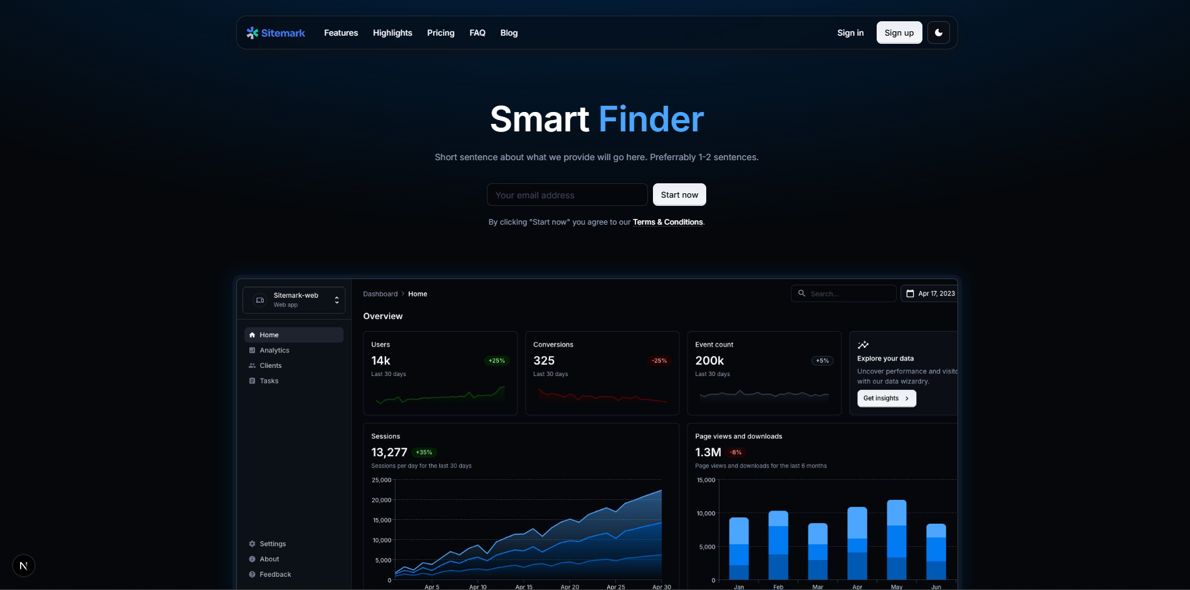
What is Smart Finder? And who needs it?

Slide 4





Tech Stack
Front End: React.JS, Next.JS, MUI
Back End: Node.JS, Python, APIs (Google Maps)
DBMS: MySQL
Infrastructure: Docker
Dashboard Tools: Tableau

Slide 5
How will we generate revenue?
User Roles:
Regular Members: Basic plan, limited to a 0.75 radius view.
Plus: Has access to all of NYC deli map.
Pro: Same benefits as Plus but with a feature to add or remove deli’s as well as potential advertisement opportunities.
Pricing:
Plus: $5 a month
Pro: $7 a month

Slide 6
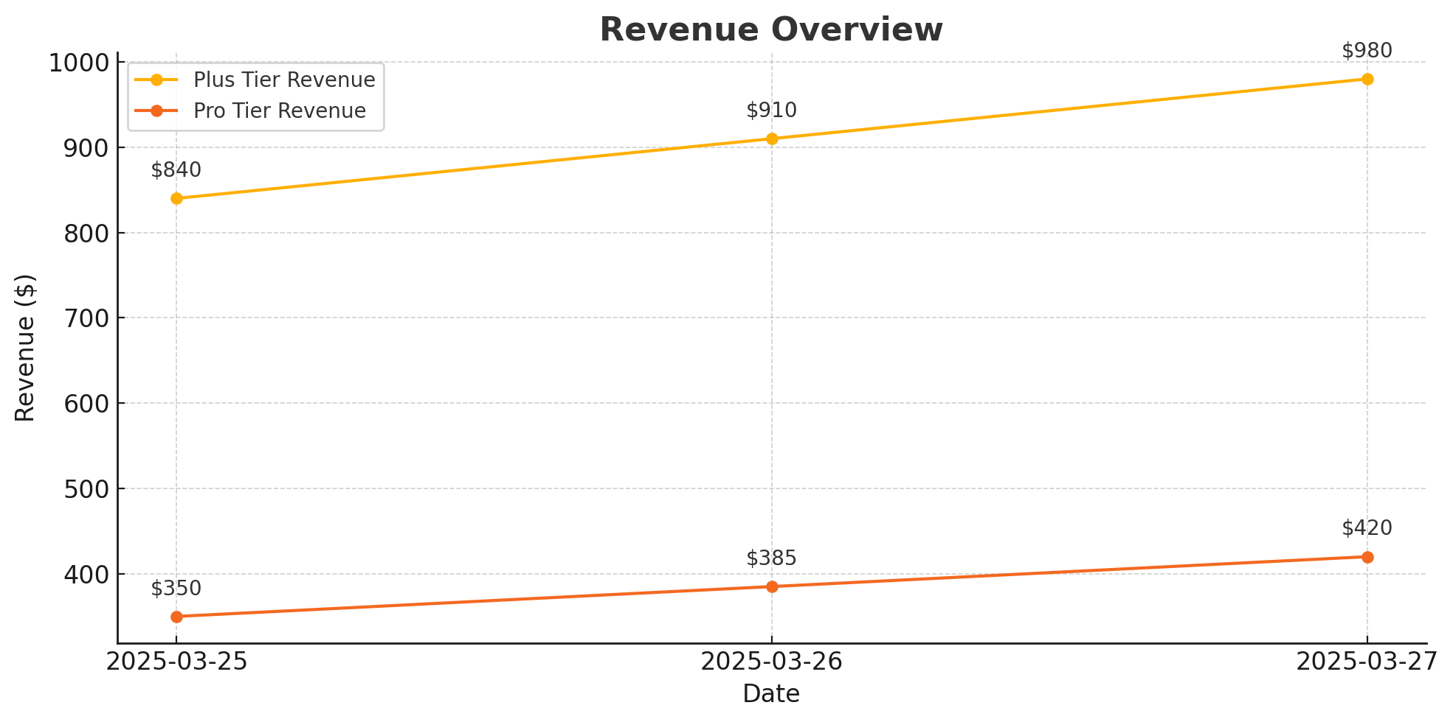
Revenue Reporting & Tech
Stripe:
Why Stripe?: We have chosen Stripe as our payment platform for its reliability, security, and seamless integration capabilities.

Slide 7
Data Collection
Data Sources:
Yelp API & Google Maps API: Store names, ratings, reviews, locations
User Submissions: Reviews and prices collected via app forms
Data Formats:
JSON for API responses
CSVs used for structuring before database import

Slide 8
Data Cleaning and Preparation
Cleaning Process:
Remove duplicates and standardize BEC-related terms
Normalize timestamps and addresses
Fill or flag missing price and rating data
Database Readiness:
Data cleaned and formatted for MySQL
Structure supports 2NF normalization for relational database design

Slide 9
Data Visualization and Integration
Types of Visualizations:
Map View: BEC density across NYC by rating/price
Histogram: Price distribution by neighborhood
Leaderboard: Top 10 highest-rated BEC spots
Tools & Integration:
Built using Tableau
Dashboards published on Tableau Public and embedded in the app via <iframe>

Slide 10
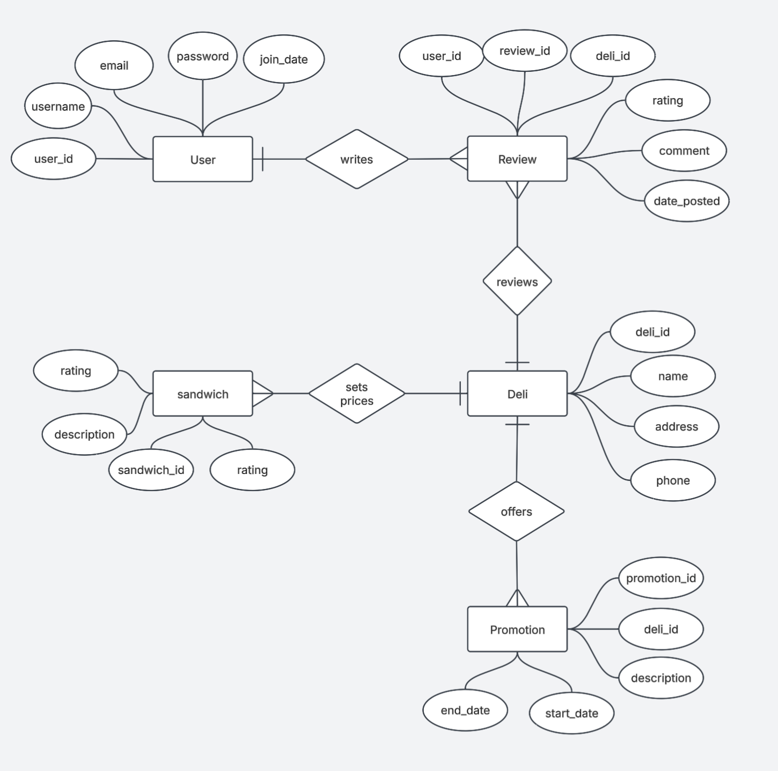
ER
Diagram

Slide 11
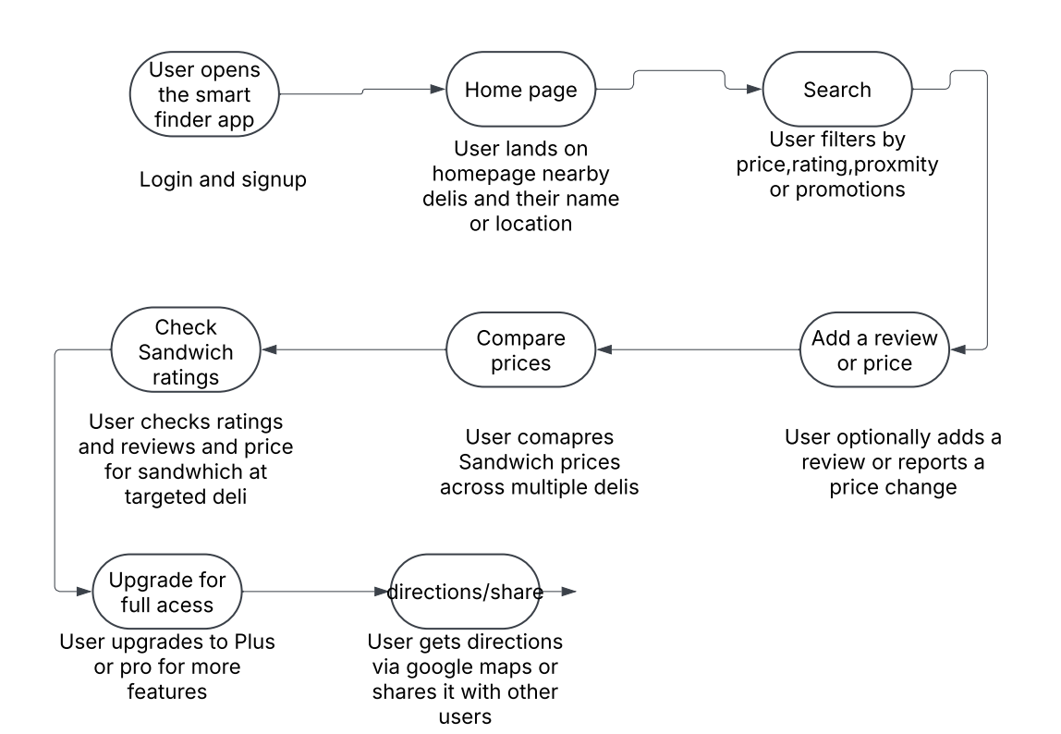
User Journey
Example:

Slide 12
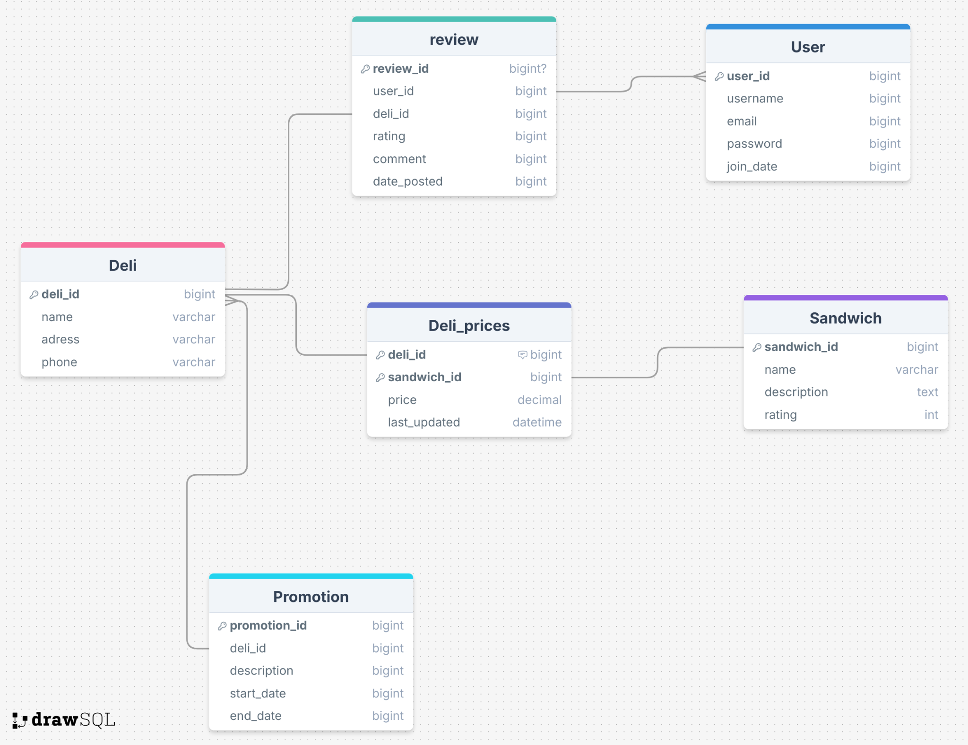
Relational
Data
Model

Slide 13
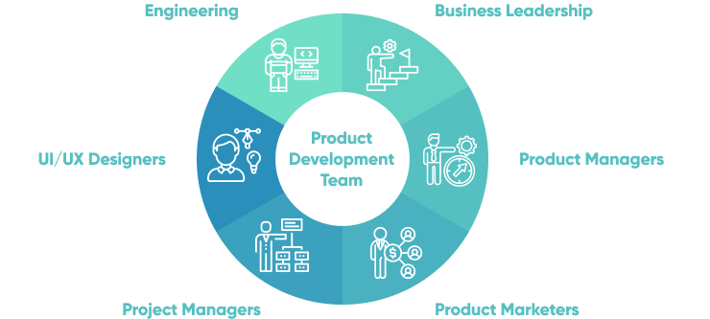
Member Roles
Hamim - MySQL, Docker, helping with frontend
Alexis - Frontend (main), Revenue manager
Kevin - Backend / Data Visualization
Eduardo - Backend
Kenneth - Frontend (main), React, MUI, Next
Sahaf - Frontend & Backend

Slide 14
Q&A

